Slide 1
Lecture 17 Generation of Sinusoidal Voltage - 2

Slide 2
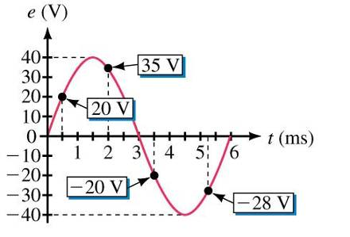
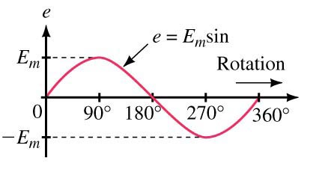
Instantaneous Value
The instantaneous value is the value of the voltage at a particular instant in time.
α
The instantaneous value of the waveform can be determined by solving the equation for a specific value of θ.
For example, if θ =37⁰ and amplitude were 10V, then the instantaneous value at that point would be:

Slide 3
Example
A sine wave has a value of 50V at α = 150˚. What is the value of E_{m} (the amplitude)?
α

Slide 4
Effective (RMS) Values
Effective values tell us about a waveform’s ability to do work.
An effective value is an equivalent DC value.
It tells how many volts or amps of DC that an AC waveform supplies in terms of its ability to produce the same average power.
They are “Root Mean Squared” (RMS) values:
The terms RMS and effective are synonymous.

Slide 5
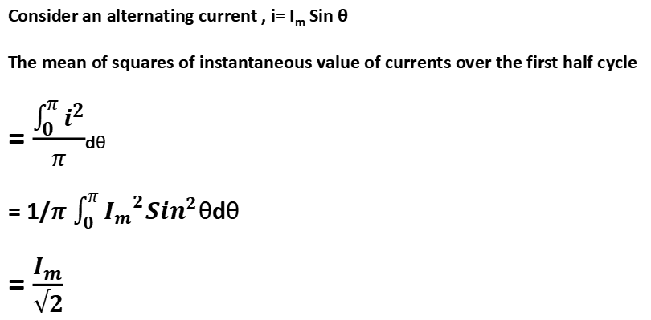
Effective (RMS) Values
RMs value (effective value of an alternating current is defined as that equivalent steady
direct current which when flowing through a given resistance for a given time produces
the same amount of heat energy as produced by the alternating current flowing through
the same resistance for the same time.
Consider an alternating current , i= I_{m} Sin θ
The mean of squares of instantaneous value of currents over the first half cycle
= $\frac{\int_{0}^{π}{i^{2}}}{π}$dθ
= 1/𝜋 $\int_{0}^{π}{{I_{m}}^{2}{Sin}^{2}}$θdθ
= $\frac{I_{m}}{√2}$

Slide 6
Example
Tie it all together:
The 120VDC source shown delivers 3.6 W to the load. Determine the peak values of the sinusoidal voltage and current (E_{m} and I_{M}) such that the AC source delivers the same power to the load.

Slide 7
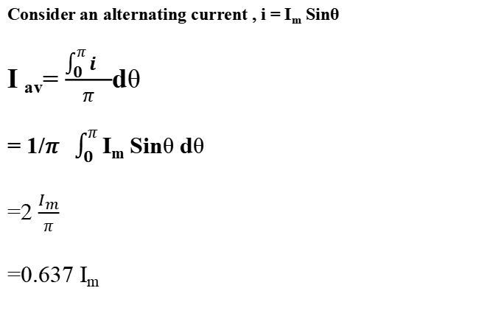
Average Values
Average value of an alternating current (I_{av}) is defined as that steady direct current which
Transfers across any circuit the same amount of charge as is transferred by the alternating
current during the same time.
Consider an alternating current , i = I_{m} Sinθ
I _{av}= $\frac{\int_{0}^{π}{i^{}}}{π}$dθ
= 1/𝜋 $\int_{0}^{π}{\text{I}\text{m} \text{Sin}\text{θ} \text{d}\text{θ} }$
=2 $\frac{I_{m}}{π}$
=0.637 I_{m}

Slide 8
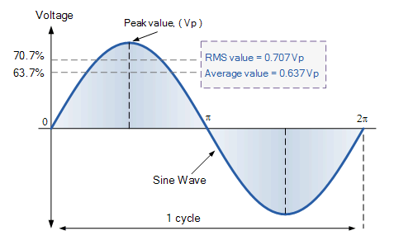
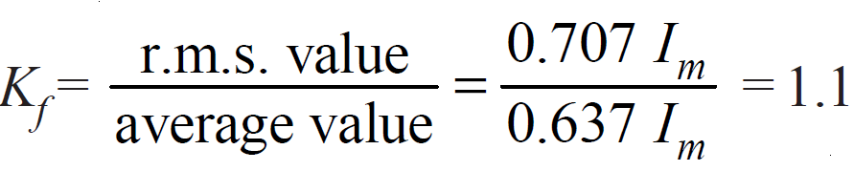

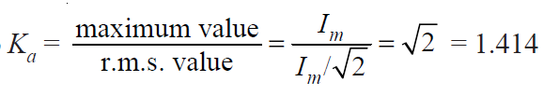
Sinusoidal Signal- Specifications

Slide 9
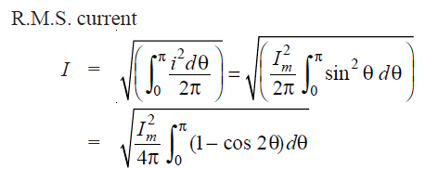
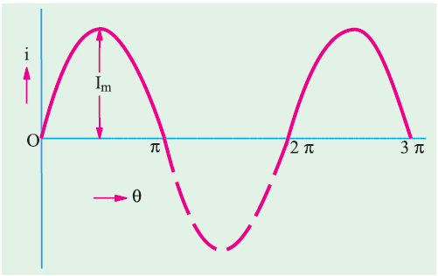


Example - Half Wave Rectifier Output RMS Value

Slide 10


Example - Half Wave Rectifier Output Average Value

Slide 11
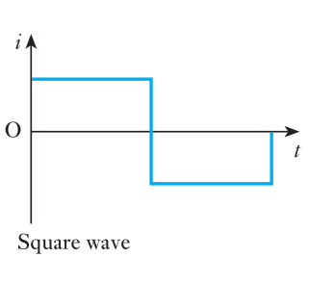
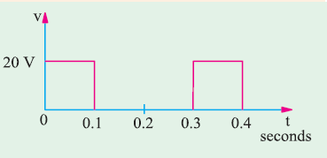
HOME WORK
Find the RMS value of the following waveforms?

Slide 12
Thank You

